Slide 1
OCP Chapter 17
Roger Janssen
CodeBoosters

Slide 2

Introduction
Modules

Slide 3
OCP CH17 Modules
Review keywords for module-info file
exports <package name>: exposes a package to other modules
exports <package name> to <module>: exposes a package to a specific module only
requires [transitive] <module name>: adds a dependency upon another module
Notes:
Covered in chapter 11.

Slide 4
OCP CH17 Modules
Review keywords for module-info file
provides <interface> with <implementation> : specifies that a class provides an implementation of a service interface
uses <interface>: specifies that a module is relying on a service
opens : opens a package for reflection
Notes:
Covered in this chapter!

Slide 5
OCP CH17 Modules
Module types
Named module : a (proper) java module
Automatic module : a regular jar on the module path
Unnamed module : a regular jar on the class path
Notes:
Named module: a module containing a module-info file.
Automatic module: a regular jar without a module-info file but placed on the module path.
- treated as if there were a module-info file
- all packages are exported
- automatic module name determination
- remove the file extension from the JAR name.
- remove any version information from the end of the name. A version is digits and dots with possible extra information at the end, for example, ‐1.0.0 or ‐1.0‐RC.
- replace any remaining characters other than letters and numbers with dots.
- replace any sequences of dots with a single dot.
- remove the dot if it is the first or last character of the result.
Unnamed modele : a regular jar without a module-info file but placed on the class path.
- it doesn't export any packaged to named/automatic modules
- it can read from any JAR on the class AND module path : the reason why all non-modular code runs on java9+

Slide 6
OCP CH17 Modules
Named module
A (proper) java module, with module-info file deployed on the module path.
Module name is in the module-info file.

Slide 7
OCP CH17 Modules
Automatic module
A regular jar – no module-info file – that gets deployed on the module path.
Treated as if there was a module-info file
Module name will be determined bij the JVM.
All packages are exported.

Slide 8
OCP CH17 Modules
Unnamed module
A regular jar without a module-info file and placed on the class path.
- It doesn't export any packages to named/automatic modules.
- It reads from any JAR on the class AND module path.
Notes:
It can access all classes in all jars in the module path. Non of the names modules can access any class form an unnamed module.

Slide 9
OCP CH17 Modules
Question
What happens if an unnamed module has a module-info file?
Answer
It will be ignored.
Notes:
This implies we had a proper java module packaged in a jar but deployed it on the classpath. It can be access by other classes on the class patha and will be hidden for named modules.

Slide 10
OCP CH17 Modules
Automatic module name determination
1. remove the file extension from the JAR name
2. remove any version information from the end of the nam
3. replace any remaining characters other than letters and numbers with dots
4. replace any sequences of dots with a single dot.
5. remove the dot if it is the first or last character of the result.
Notes:
A version is digits and dots with possible extra information at the end, for example, ‐1.0.0 or ‐1.0‐RC.

Slide 11
OCP CH17 Modules
Example module name determination
 | Description | Example 1 | Example 2
1 | JAR name | commons2‐x‐1.0.0‐SNAPSHOT.jar | mod_$‐1.0.jar
2 | Remove file extension | commons2‐x‐1.0.0‐SNAPSHOT | mod_$‐1.0
3 | Remove version information | commons2‐x | mod_$
4 | Replace special characters | commons2.x | mod..
5 | Replace sequence of dots | commons2.x | mod.
6 | Remove leading trailing dots | commons2.x | mod

Slide 12
OCP CH17 Modules
Question
Does an automatic module have a module-info file?
Answer
No. A named module does. An unnamed module may have such a file but it will be ignored!

Slide 13
OCP CH17 Modules
Question
Is an unnamed module readable by other modules on the module path?
Answer
No. Only named and automatic modules are accessible from the module path!

Slide 14
OCP CH11 Modules
Migrating non modular applications
Bottom up
Create dependency graph of the packages / libs
Start with the package/lib that has no dependencies
Add module-info (with exports, requires)
Move to the module path
Repeat from 2
Notes:
This approach works best when you have the power to convert any JAR files that aren't already modules.

Slide 15
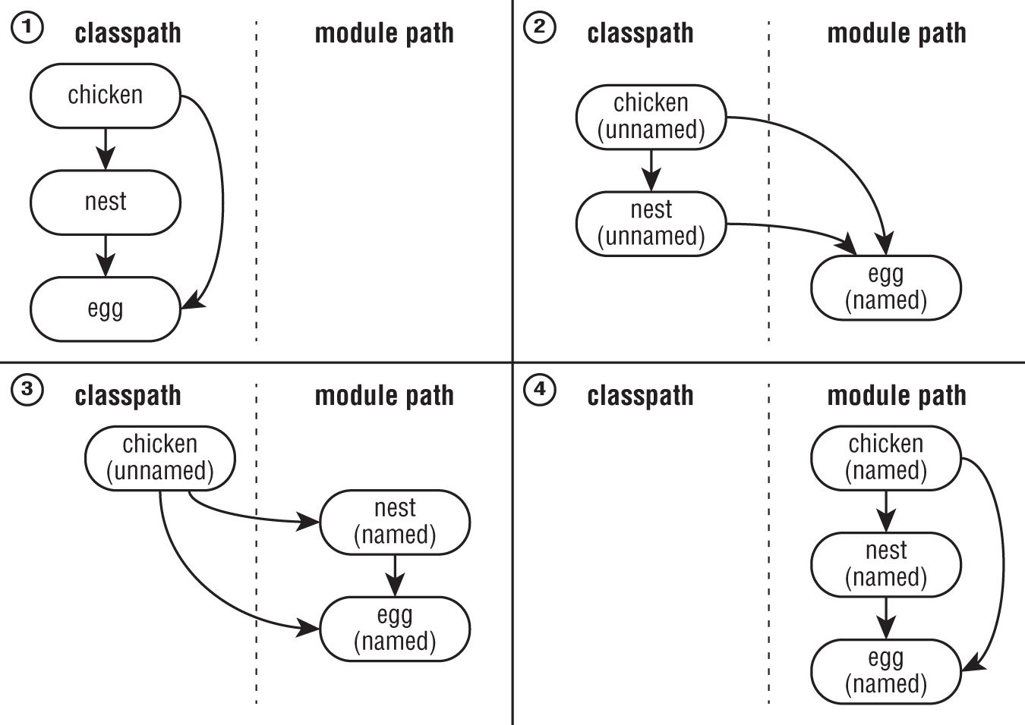
OCP CH11 Modules

Slide 16
OCP CH11 Modules
Top down
Create dependency graph of the packages / libs
Put all packages / libs on the module path
Select the highest level that has not yet been migrated
Add module-info (with exports, requires)
use the automatic derived names for the required modules
Repeat from 3
Notes:
A top‐down migration strategy is most useful when you don't have control of every JAR file used by your application.

Slide 17
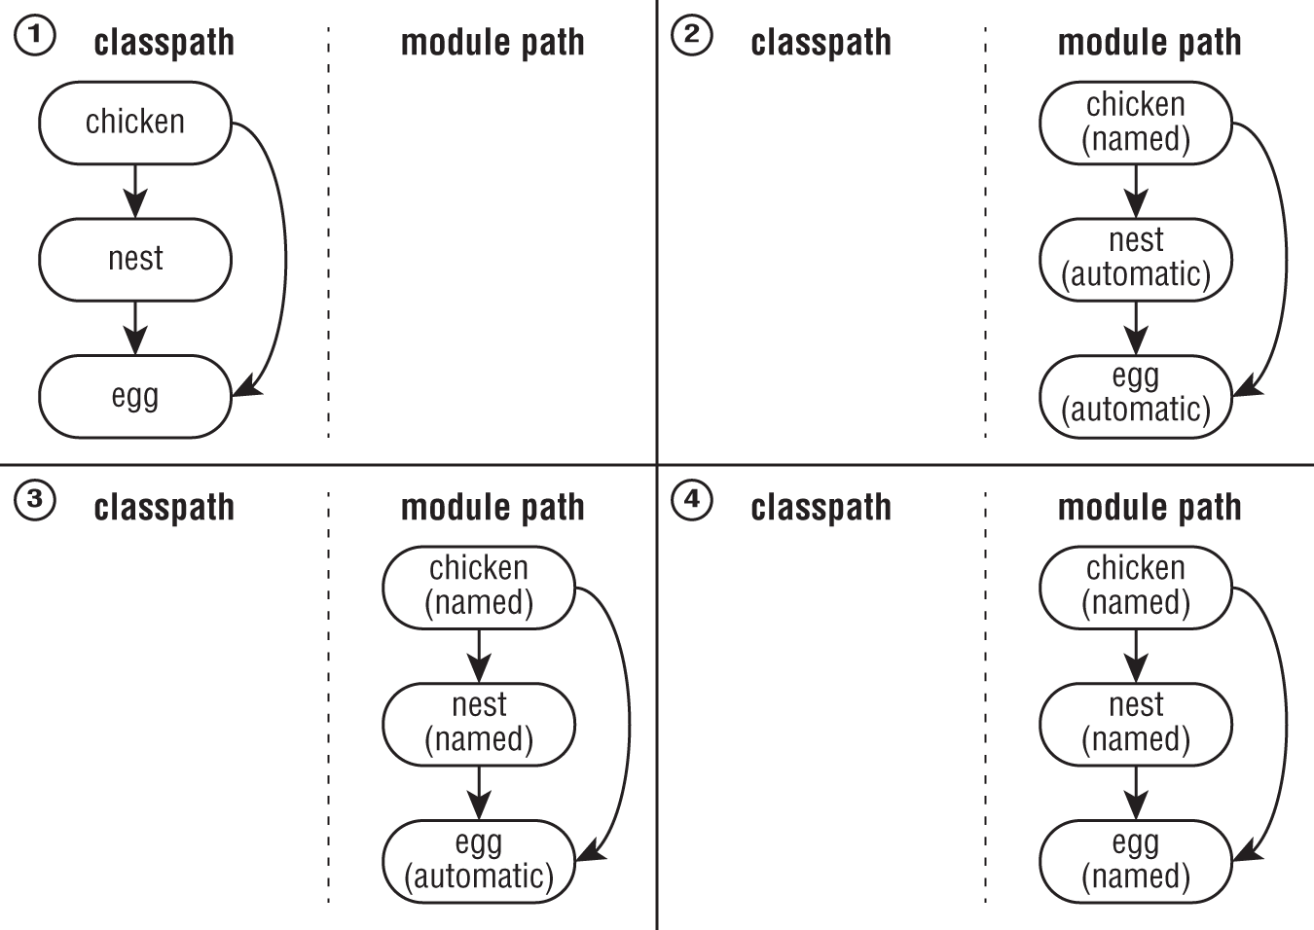
OCP CH11 Modules

Slide 18
OCP CH11 Modules
Migration strategies compared
Category | Bottom up | Top down
A project that depends on all others | Unnamed module on the classpath | Named module on the module path
A project that has no dependencies | Named module on the module path | Automatic module on the module path
Bottom up: when your are in control of all libs/jars.
Top down: when you are not in control of all libs/jars.

Slide 19
OCP CH17 Modules
Services
Consist of:
an interface / abstract class decribing the service
any classes the interface references
some method of looking up implementations of the service
Note that implementations are not part of the service!

Slide 20
OCP CH17 Modules
Services
Artifact | Part of service? | Directives required
Service provider interface | Yes | exports
Service provider | No | requires, provides
Service locator | Yes | exports, requires, uses
Consumer | No | requires
Important methods of the ServiceLoader (for the exam):
public static <S> ServiceLoader<S> load(Class<S> service) { … }
public Stream<Provider<S>> stream() { … }

Slide 21


OCP CH17 Modules
Example Service
Service
Module developer.api
module-info.java
exports developer.api
Module developer.pool
module-info.java
exports developer.pool; requires transitive developer.api; uses developer.api.Developer;
Module company
module-info.java
exports company; requires developer.pool;
Module developer.hipo
module-info.java
requires developer.api provides developer.api.Developer with developer.hipo.ProDev;
Implementation
Notes:
Demo with coding!

Slide 22
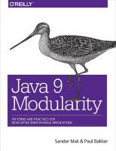
Java Modules General
Very interesting read (you’ll learn a lot more about modules than with this OCP exam):
Java 9 Modularity, O’Reilly, by Sander Mak and Paul Bakker

Slide 23
Done
Questions?

